Slide 1
Bank Analytics Project
Project presentation
prepared by Group-4

Slide 2
Introduction
Bank analytics uses data to improve decision-making in banking.
It helps in understanding customer behavior, managing risks, and increasing profitability.
This project focuses on analyzing banking data to generate meaningful insights.

Slide 3
Data Overview
Dataset includes:
• Customer Data
• Loan Data
• Transaction Data
Type: Structured Data
Used for SQL analysis and dashboard creation

Slide 4
Analysis
• Loan Analysis: Approval & rejection trends
• Customer Analysis: Segmentation based on income & age
• Transaction Analysis: Spending patterns
• Risk Analysis: Default behavior

Slide 5
KPIs
Year wise loan amount Stats
Grade and sub grade wise revol_bal
Total Payment for Verified Status Vs Total Payment for Non Verified Status
State wise and month wise loan status
Home ownership Vs last payment date stats

Slide 6
Process
• Data collection
• Data cleaning (Excel)
• SQL analysis
• KPI creation
• Dashboard creation (Power BI/Tableau)

Slide 7
Insights
• High income customers have higher loan approval
• Default rate higher in low credit score group
• Digital transactions increasing
• Certain regions contribute more revenue

Slide 8
Recommendations
• Improve credit policies
• Focus on high-value customers
• Enhance digital banking services
• Reduce risk through monitoring

Slide 9
Tools Used
• Excel
• SQL
• Power BI
• Tableau

Slide 10
Challenges & Learnings
Challenges:
• Data cleaning
• Handling large dataset
Learnings:
• SQL joins
• Data visualization
• Business insights

Slide 11
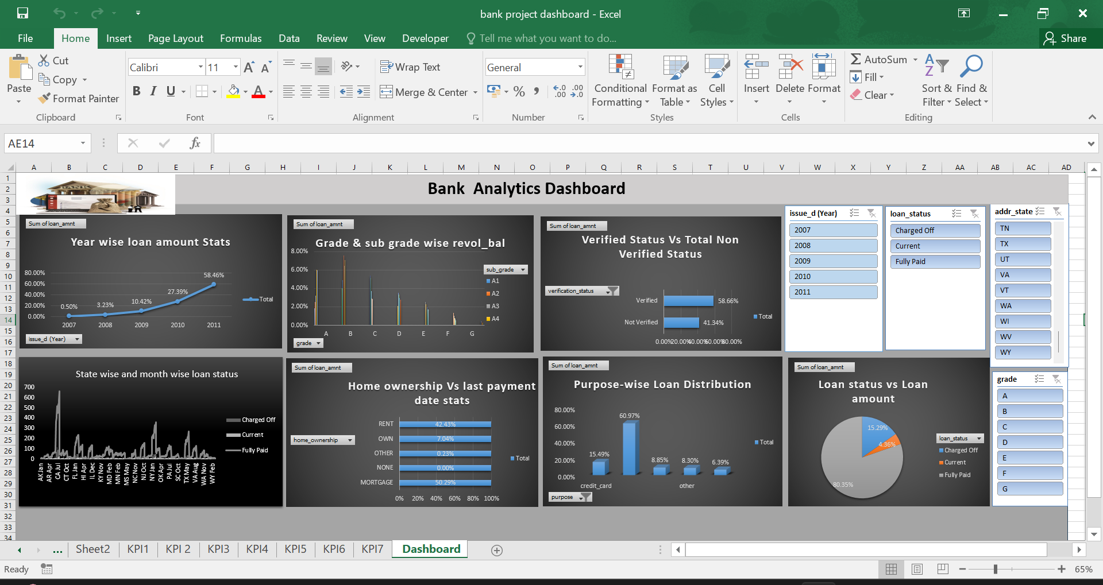
Bank Analytics Dashboard (Excel View)

Slide 12
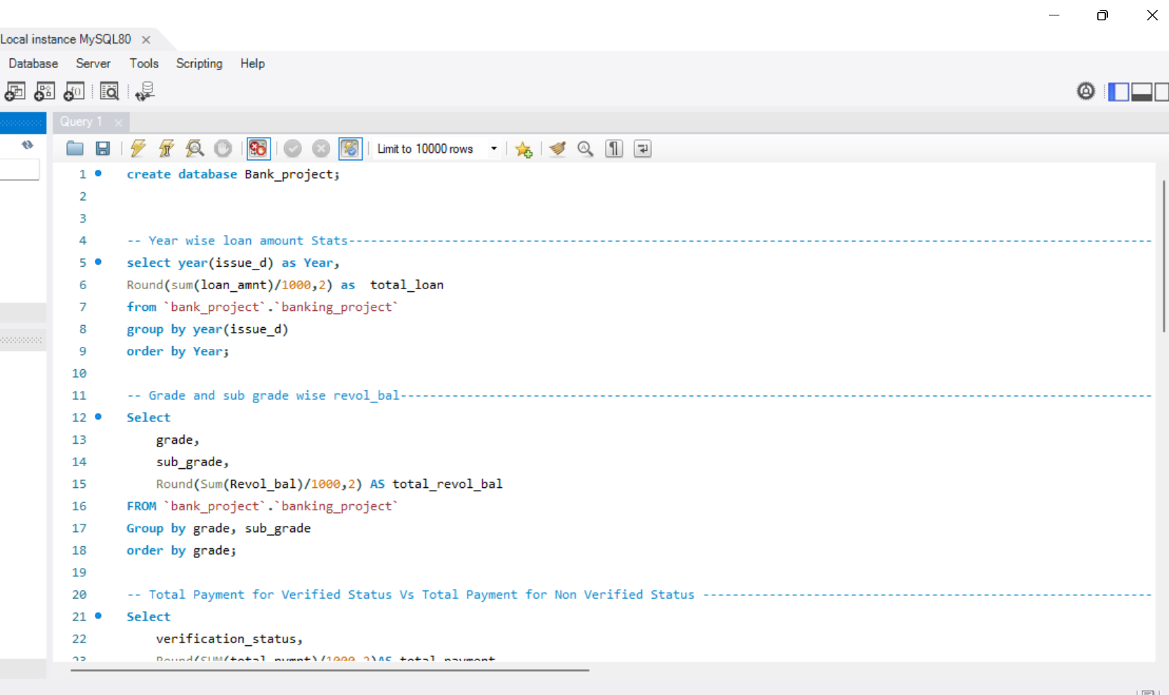
Bank Analytics Dashboard (MYSQL View)

Slide 13
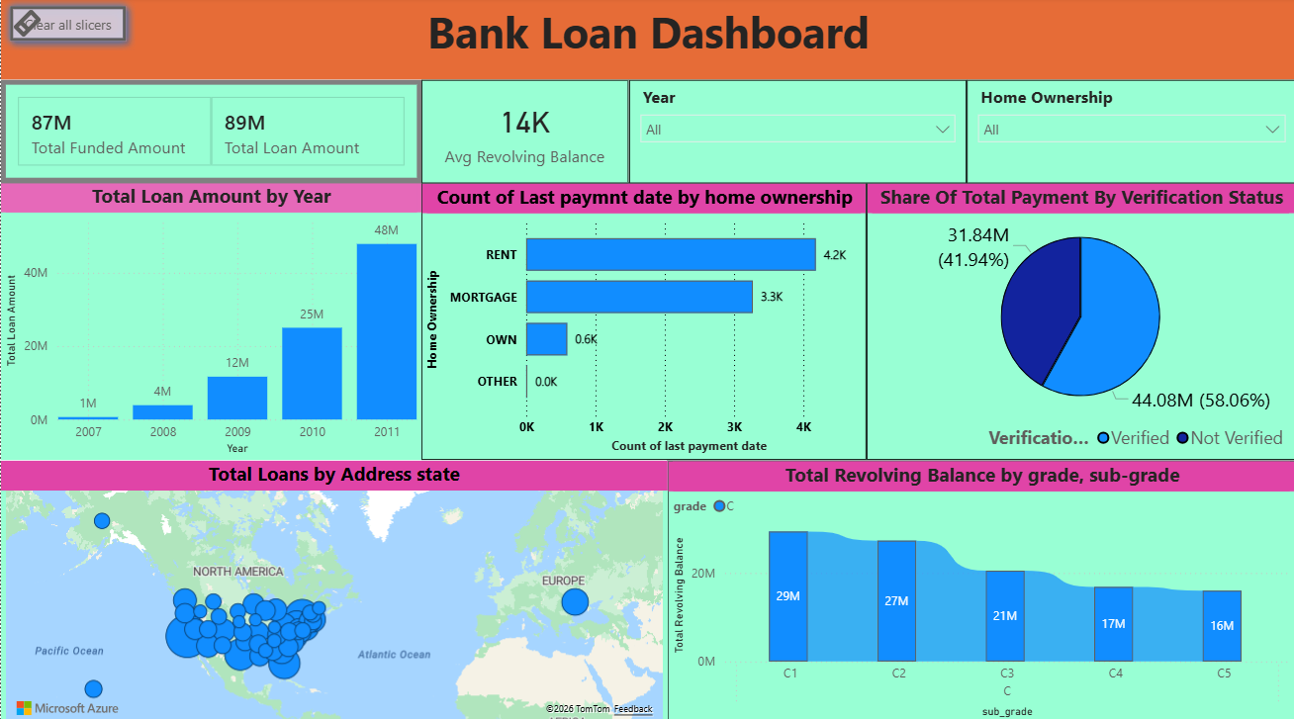
Bank Analytics Dashboard (Power BI View)

Slide 14
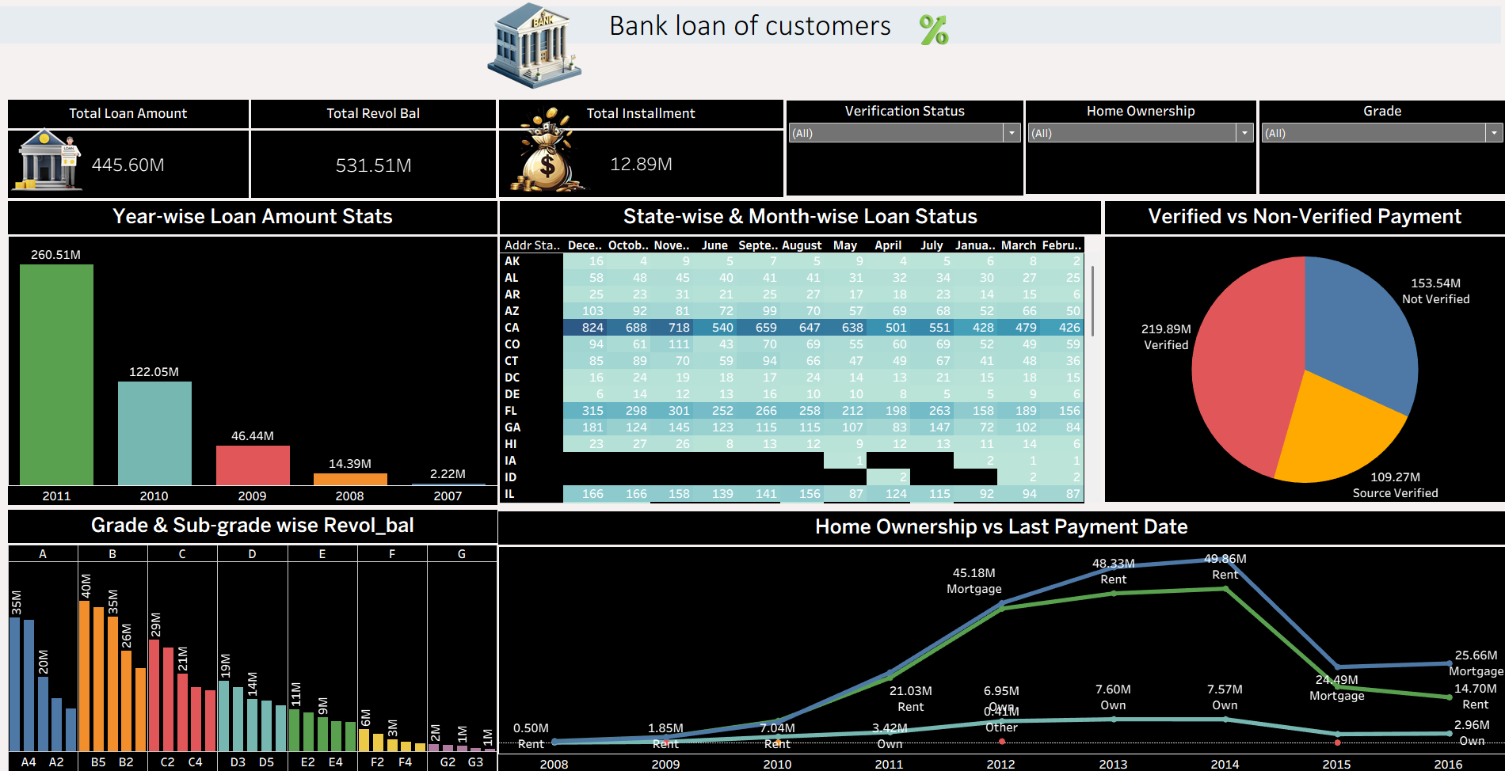
Bank Analytics Dashboard (Tableau View)

Slide 15
Conclusion
Bank analytics helps improve efficiency and decision-making.
It provides insights for better customer service and risk management.
Bank loan data analysis helped identify key trends and risks.
KPIs provided insights into customer behavior and loan performance.
The project shows how analytics improves decision-making in banking.

Slide 16
Thank You
Thank You!

